Slide 1
Getting Started with iGraphics

Slide 2
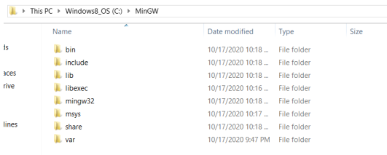
Custom MingW
First download the following zip file from Google drive (it is around 250MB, a separate compiler for C, C++)
https://drive.google.com/drive/folders/1mfG4K2USUsIdm-vJfHSe38VwYL5iR7yH?usp=sharing
Now move this file in C directory and extract the file in C directory (may require administrative privileges). You should see the following folders in extracted folder (C:/MinGW).

Slide 3
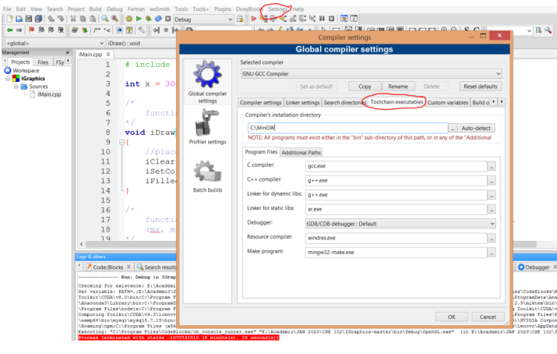
Open Codeblocks. Click Settings > Compiler and Click “Toolchain executables” tab as follows.

Slide 4
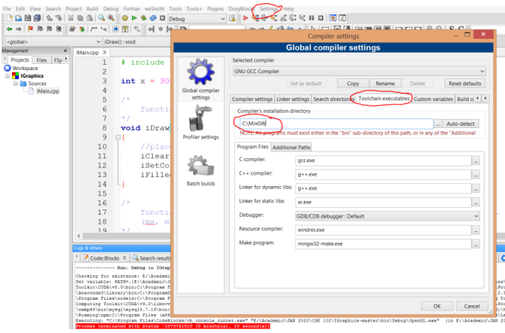
Write C:\MinGW in the Compiler’s installation directory. Leave other options as it is. Click OK.
If inside your extracted MinGW folder, you see another MinGW folder, then the path should be C:\MinGW\MinGW.

Slide 5
Copy glaux.h and glut.h to C:\MinGW\include\GL (or C:\MinGW\MinGW \include\GL)
Copy libglut32.a and glaux.lib to C:\MinGW\lib (or C:\MinGW\MinGW\lib)
Copy glu32.dll, opengl32.dll, glaux.dll and glut32.dll to C:\Windows\System32
Create a new project in CodeBlocks.

Slide 6
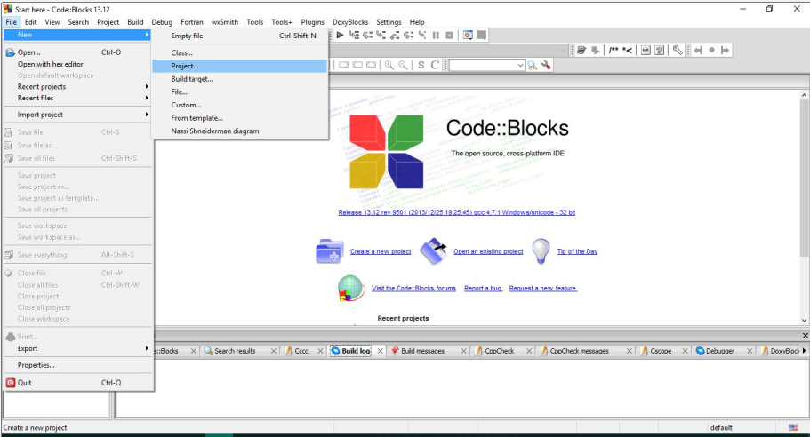

Slide 7
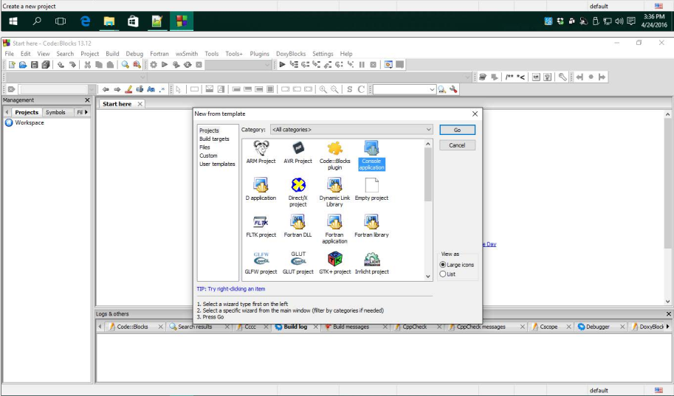

Slide 8
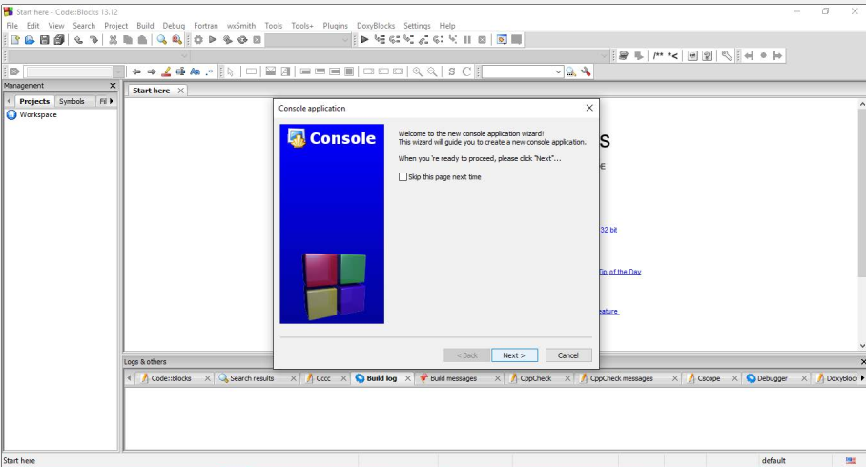

Slide 9
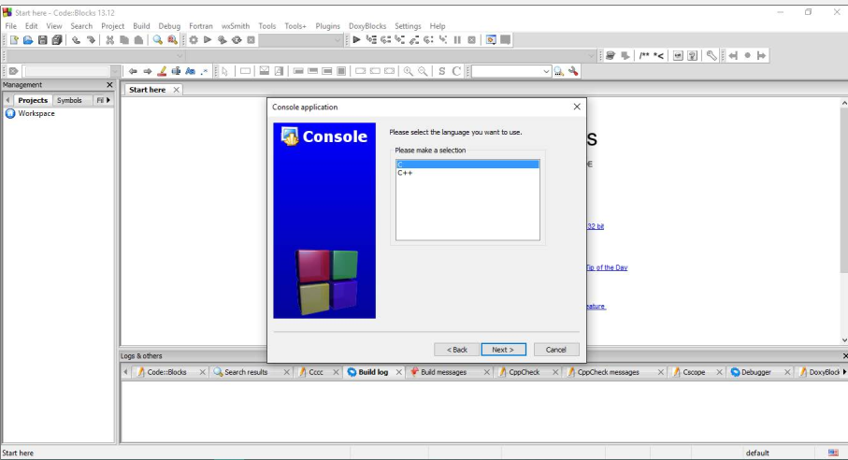

Slide 10
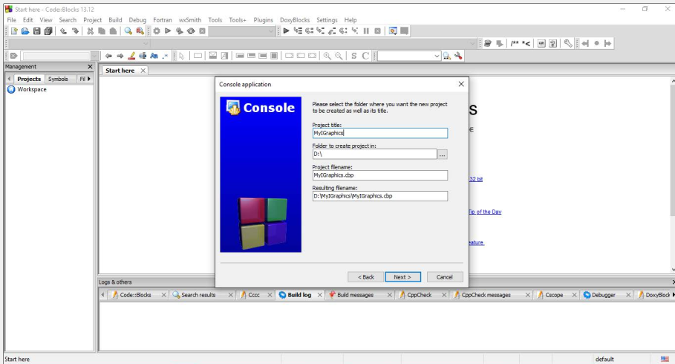

Slide 11
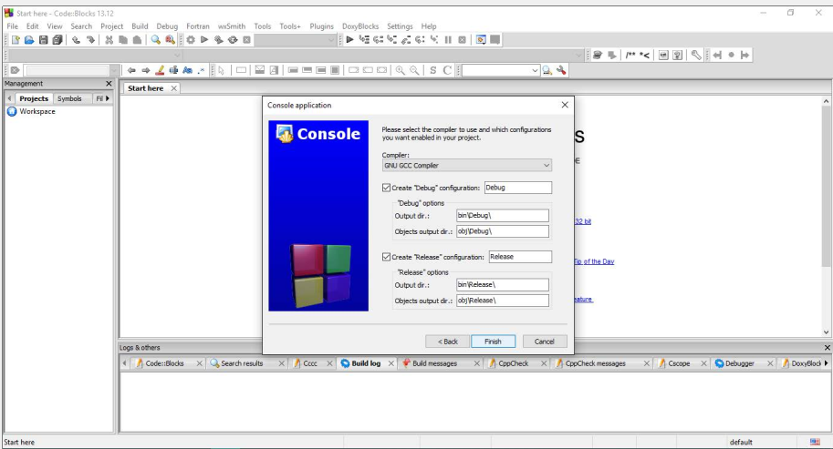

Slide 12
In any case, a project should contain only one file containing main function.
Codeblocks automatically creates a main.c file after you have created a new project.
Remove the file main.c from the project.

Slide 13
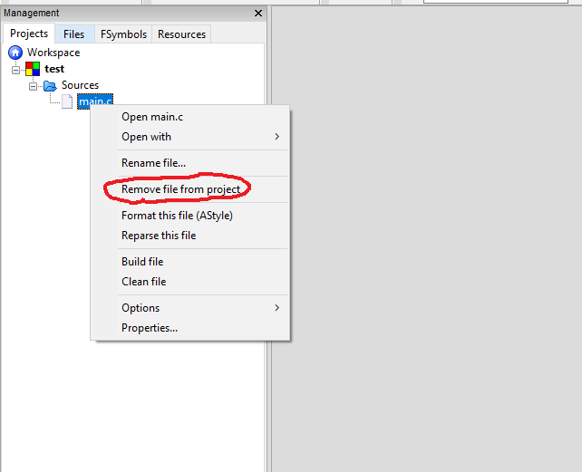

Slide 14
Copy iGraphics.h, stb_image.h, iMain.cpp and glut.h to the project folder.
iGraphics.h is the graphics library.
stb_image.h contains functions for tasks related to images.
iMain.cpp contains the main function and calls other functions. (it is a barebone file)
You may need to edit iMain.cpp file later, or you can create another cpp file containing a main function.
Instead of iMain.cpp, you can add any one of the following:
MouseDemo.cpp
TextInputDemo.cpp
SolarSystem.cpp
watch.cpp
BallDemo.cpp

Slide 15
Only copying files to the project folder doesn’t add the files to the Codeblocks project.
You have to add those files to the Codeblocks project too.

Slide 16
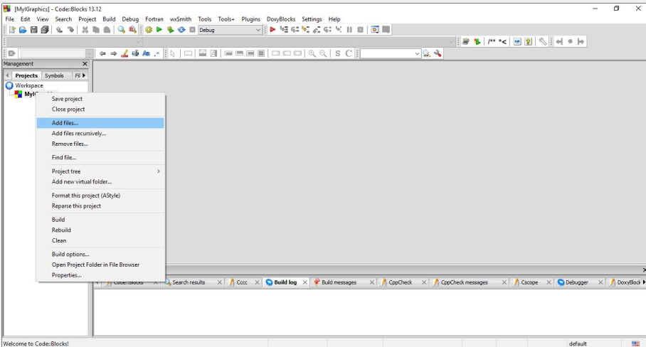

Slide 17
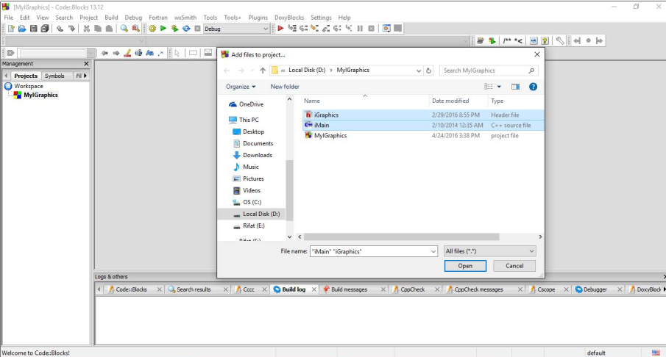



Slide 18
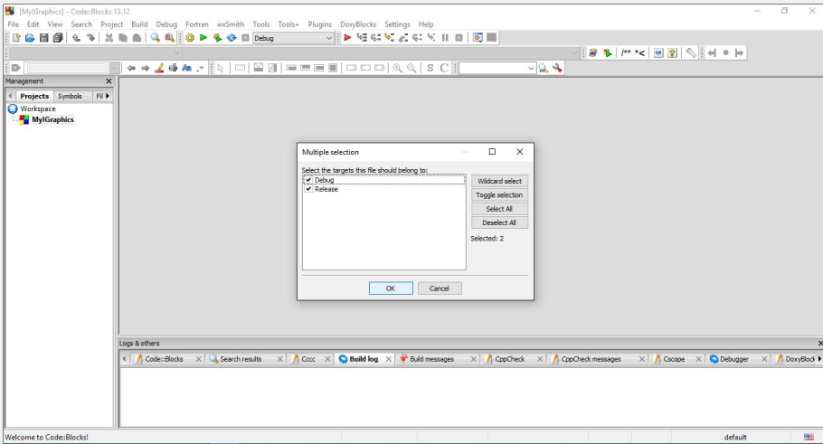

Slide 19
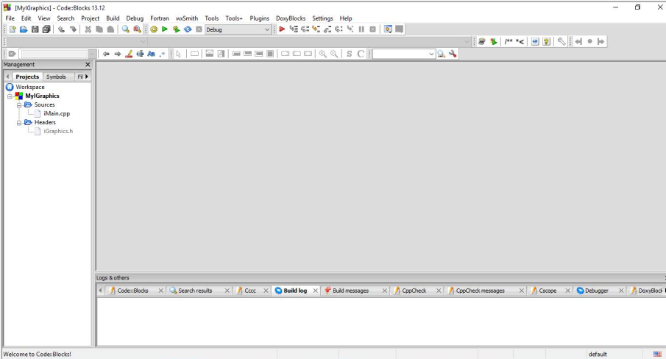
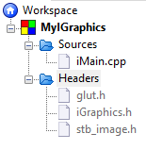
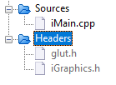

Slide 20
If you see any problem, you can remove the glut.h file from the project.

Slide 21
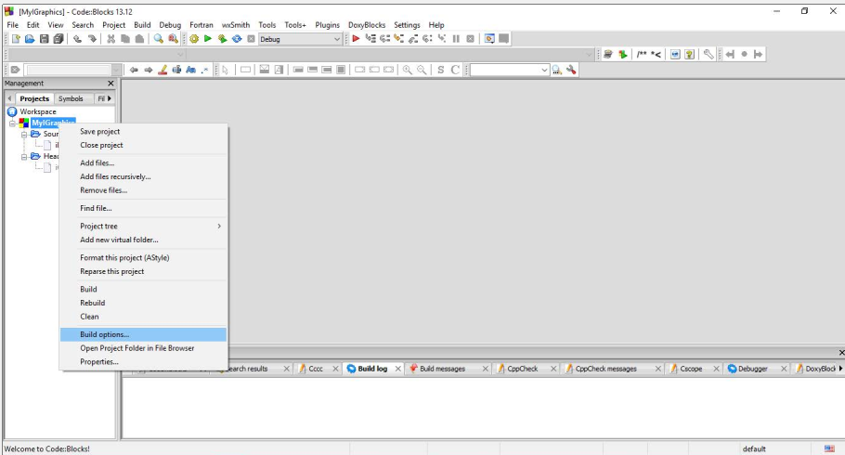

Slide 22
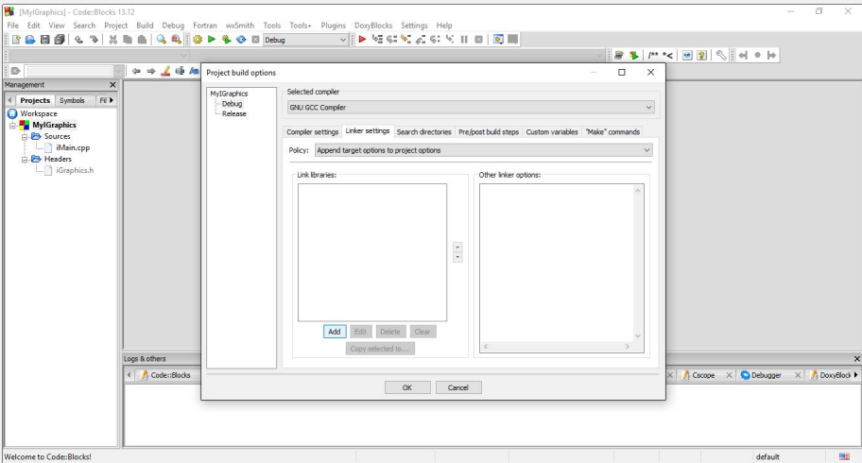

Slide 23
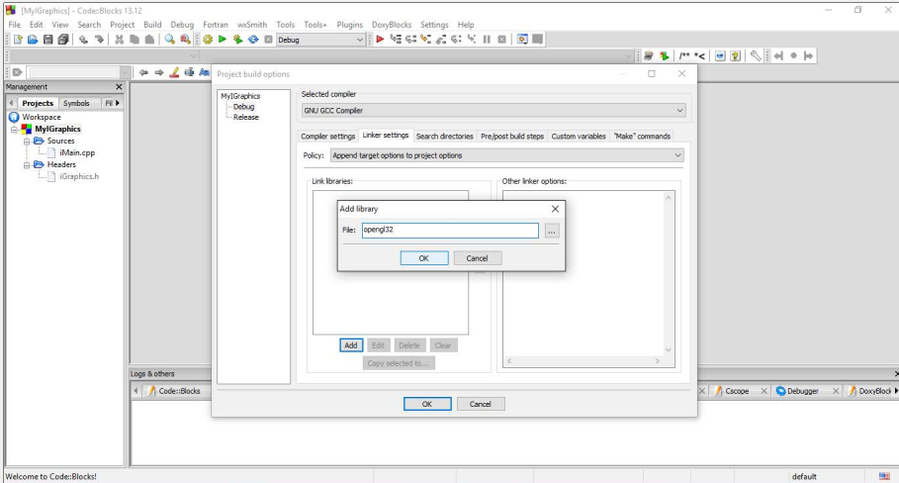

Slide 24
Add the following 4 in Link Libraries similar way:
opengl32
glu32
glut32
glaux

Slide 25
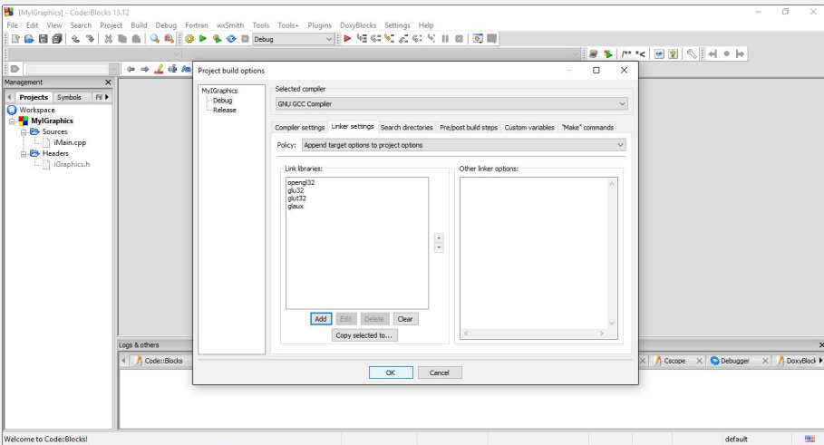

Slide 26
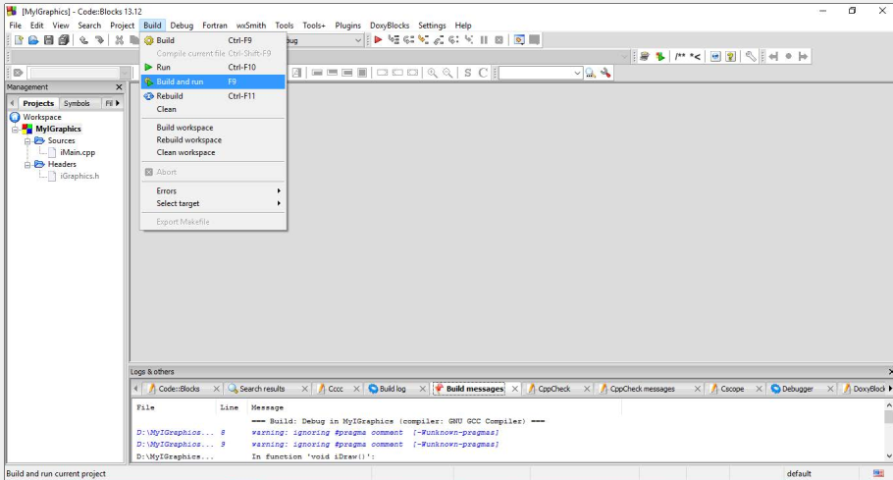

Slide 27
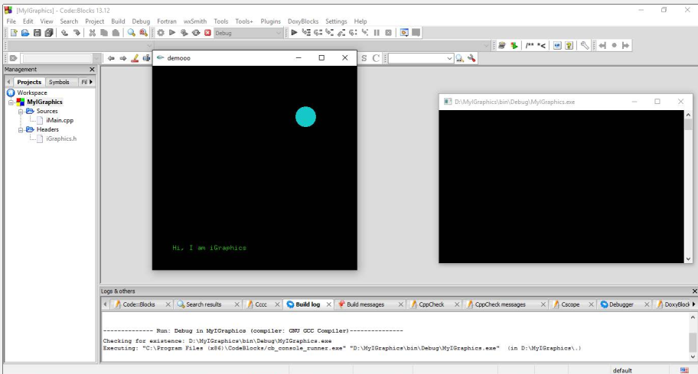

Slide 28
If you see any error at this stage related to a dll file missing, copy glu32.dll, opengl32.dll, glaux.dll and glut32.dll to the “bin/Debug” folder of your project.
If you see errors like “-lbgi not found”, download libbgi.a from the link http://www.cs.colorado.edu/~main/bgi/dev-c++/libbgi.a and then add it to C:\MinGW\lib (or C:\MinGW\MinGW\lib)

